Slide 1


At the ice cream shop

Slide 2


Slide 3
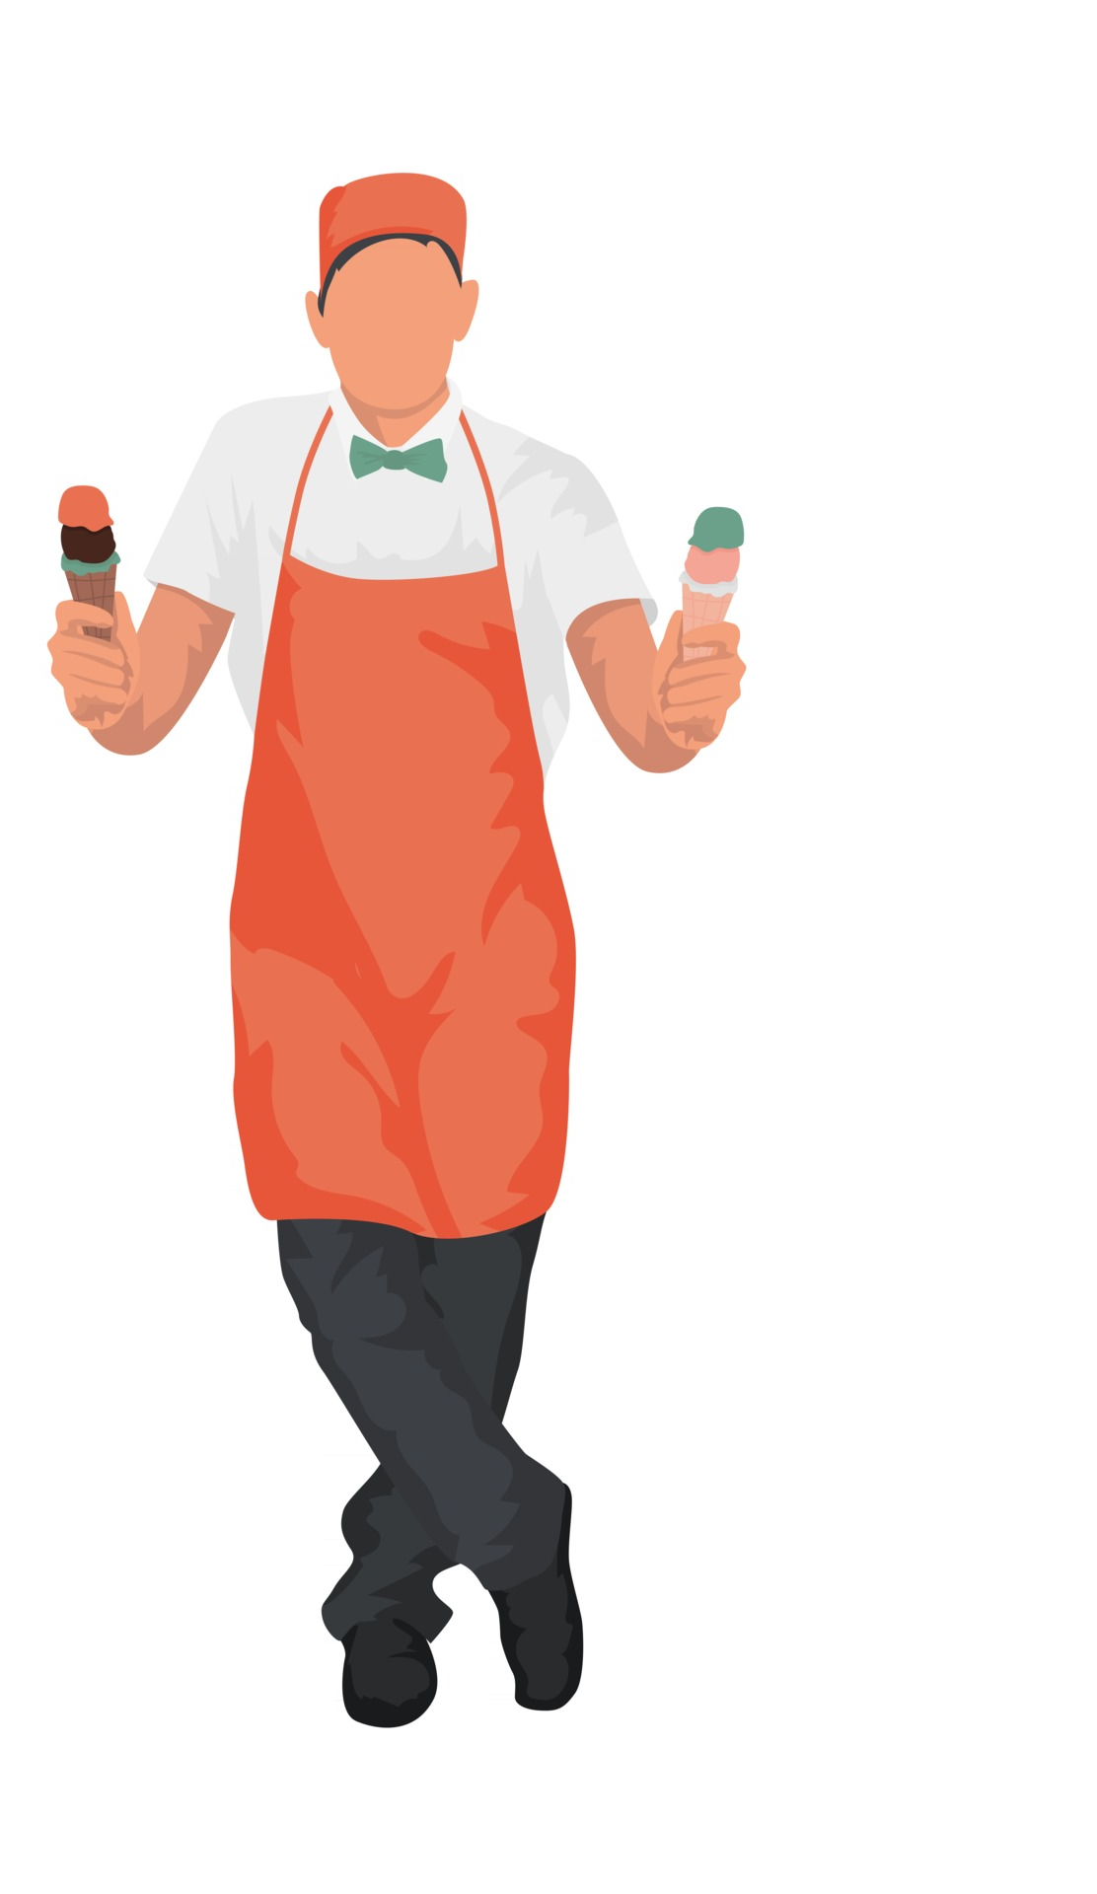
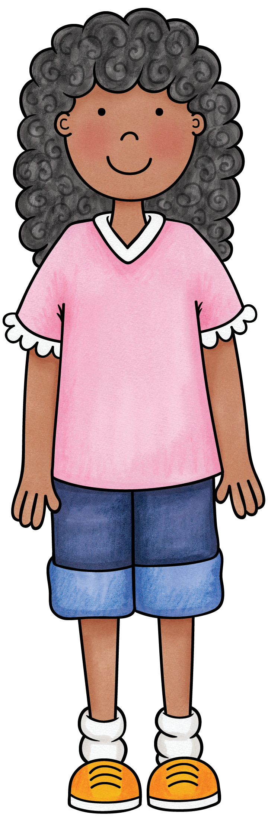
Hello.
How can I help you?
Hello.
I would like some ice cream, please.

Slide 4



I want…
one scoop
two scoops
three scoops

Slide 5

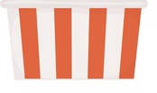
in…
a cup.
a cone.

Slide 6
What flavour would you like?
flavour = Geschmack

Slide 7

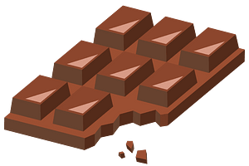

I want…
and
and
strawberry
chocolate
vanilla

Slide 8

Would you like sprinkles on top?

Slide 9


Yes, please.
No, thank you.

Slide 10
Alright. Here is your ice cream.
Thank you.

Slide 11
You are welcome.
Have a nice day.
Bye.

Slide 12


Now, it‘s your turn.

Slide 13
one scoop
a cone
two scoops
three scoops
a cup
sprinkles
strawberry
chocolate
vanilla

Slide 14
Hello. How can I help you?
 | Hello. I would like some ice cream, please. I want one scoop / two scoops / three scoops in a cone / in a cup.
What flavour would you like?
 | I want strawberry / vanilla / chocolate.
Would you like sprinkles on top?
 | Yes, please. / No, thank you.
Alright. Here is your ice cream.
 | Thank you.
You are welcome. Have a nice day.
 | Bye.

Slide 15



ice cream shop
MENU
or
topping:
Enjoy!

